Slide 1
Progress Report 5
Sprint 5 - (3/12 - 3/19)
Brian Goughnour, Josh Brown, Steve Stamey, Guylain Kibunzi, Chauncey Davidson

Slide 2
Sprint Backlog - Responsibilities
Charles Stamey - Icon importing and application splash screen implementation.
Guylain Kibunzi - HotLine GUI implementation. Link navigation bar buttons to pages.
Joshua Brown - Calendar integration and implementation.
Brian Goughnour - Integration of Goal Tracker into main project. Research and communication initial/suggested goals of typical users for app.
Chauncey Davidson - Implement Map (with the events) and begin the Information section

Slide 3
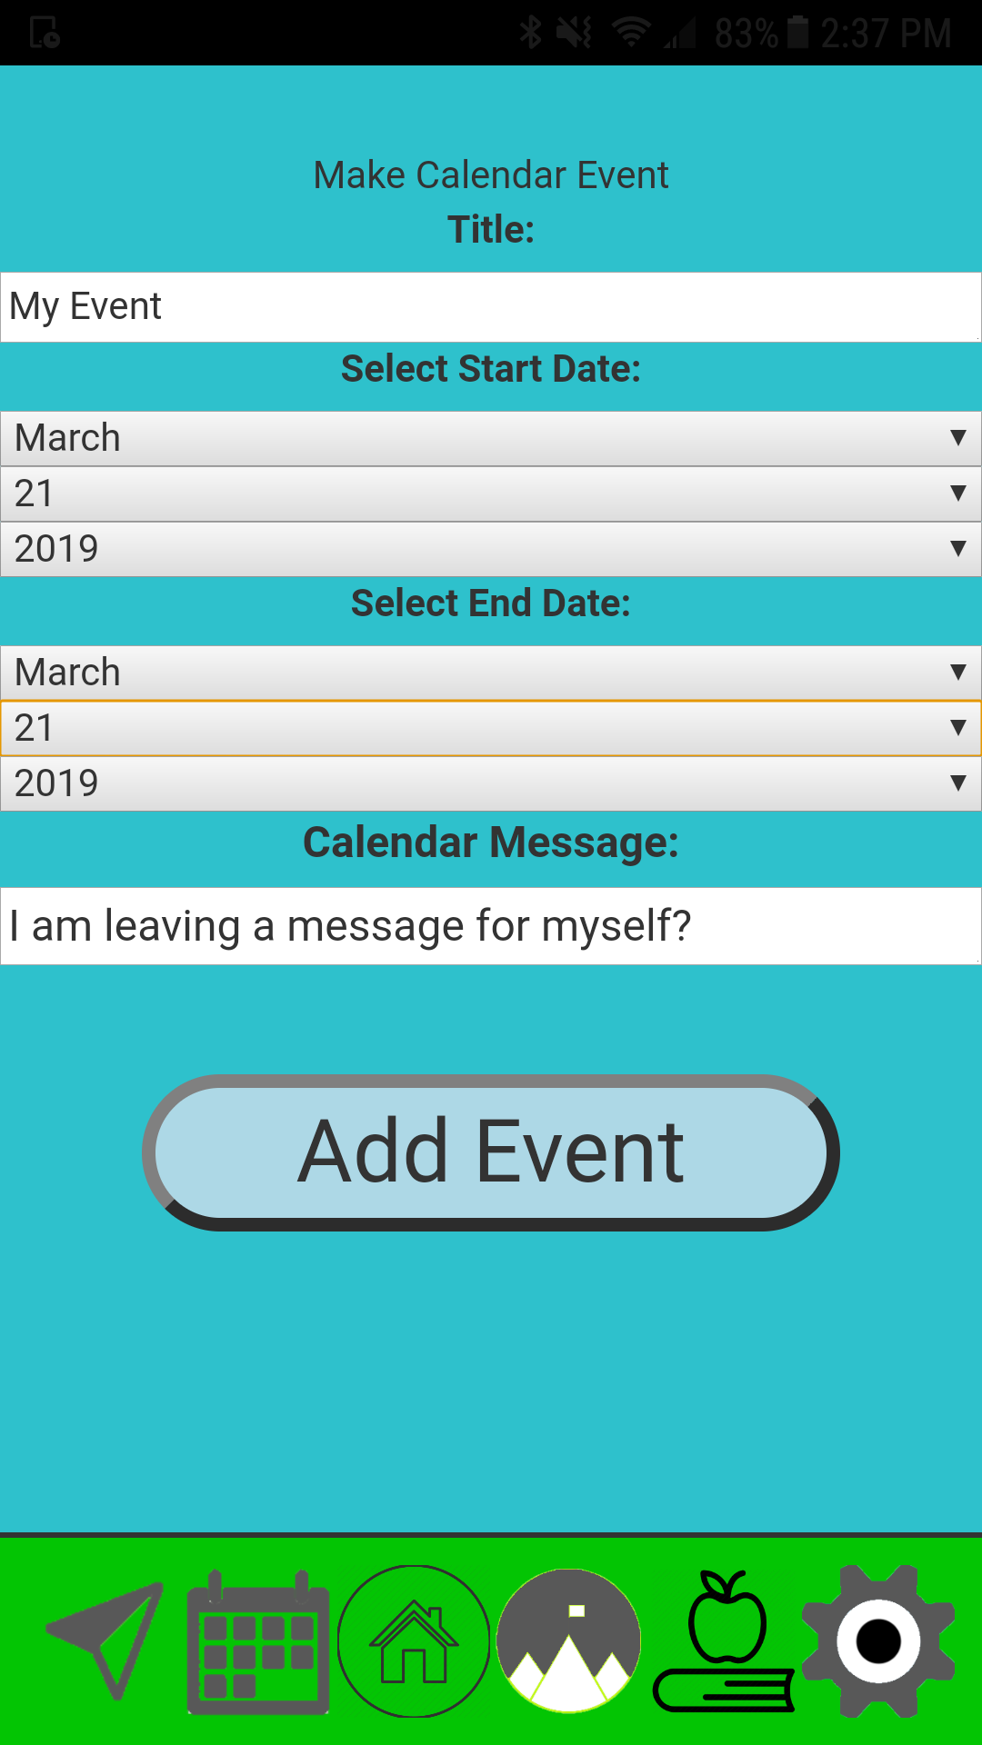
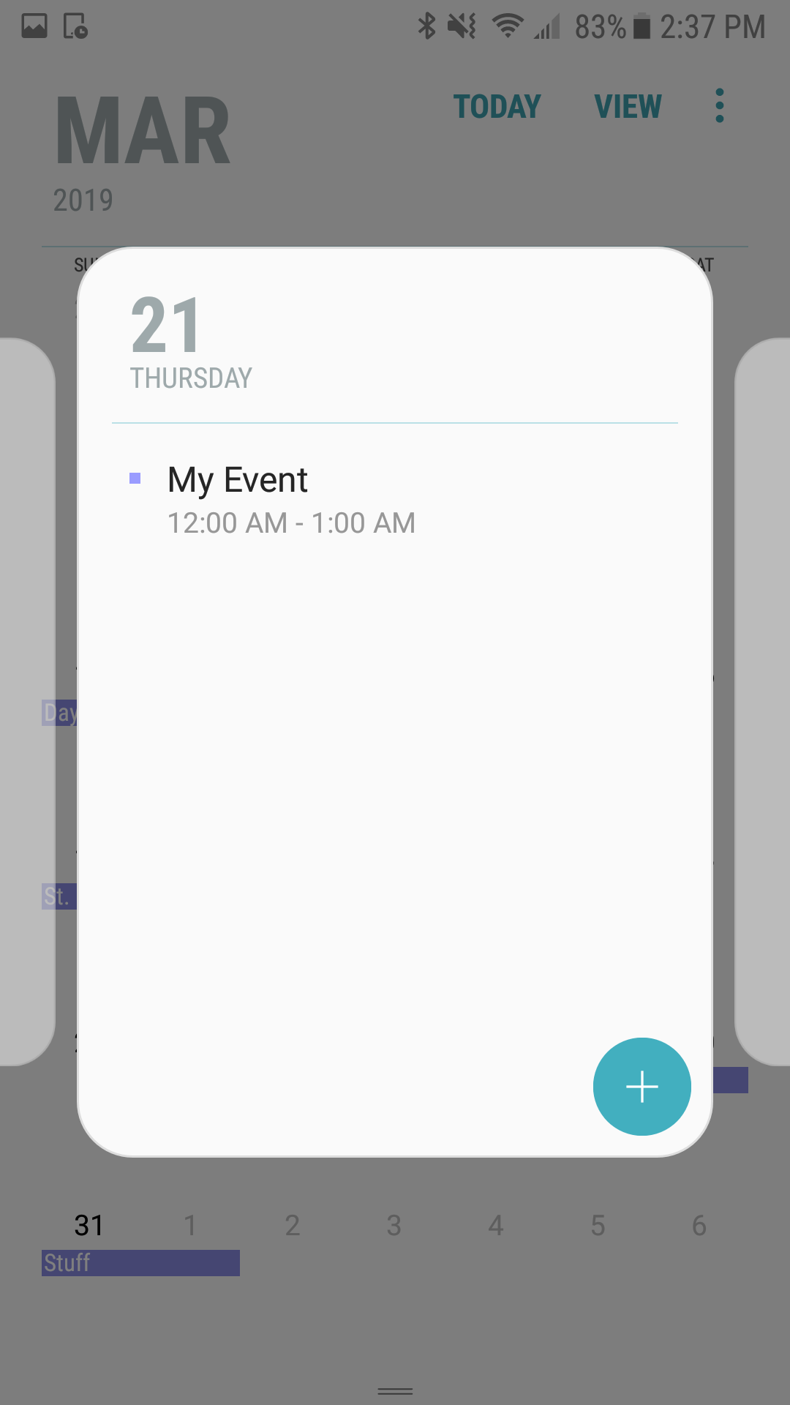
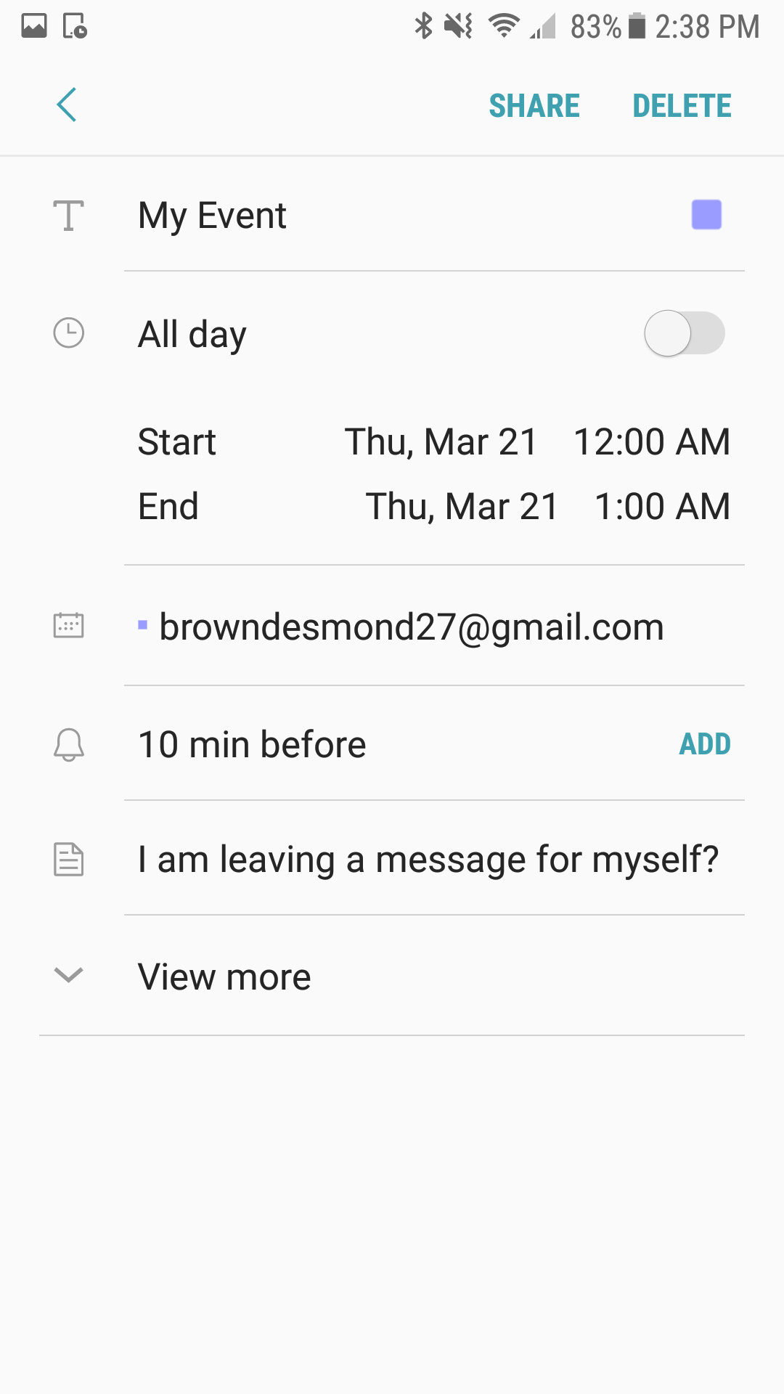
Native Calendar Linking

Slide 4
Future Sprint
Add more features to Calendar.
Editing/removing existing events
Passing Calendar data to goal tracker.
Education/Information section
Finish back end database
Adding a predetermined list for the 5 Steps to Harm Reduction to Goal Tracker.
Importing Leaflet into Map subsystem and events on map.

Slide 5
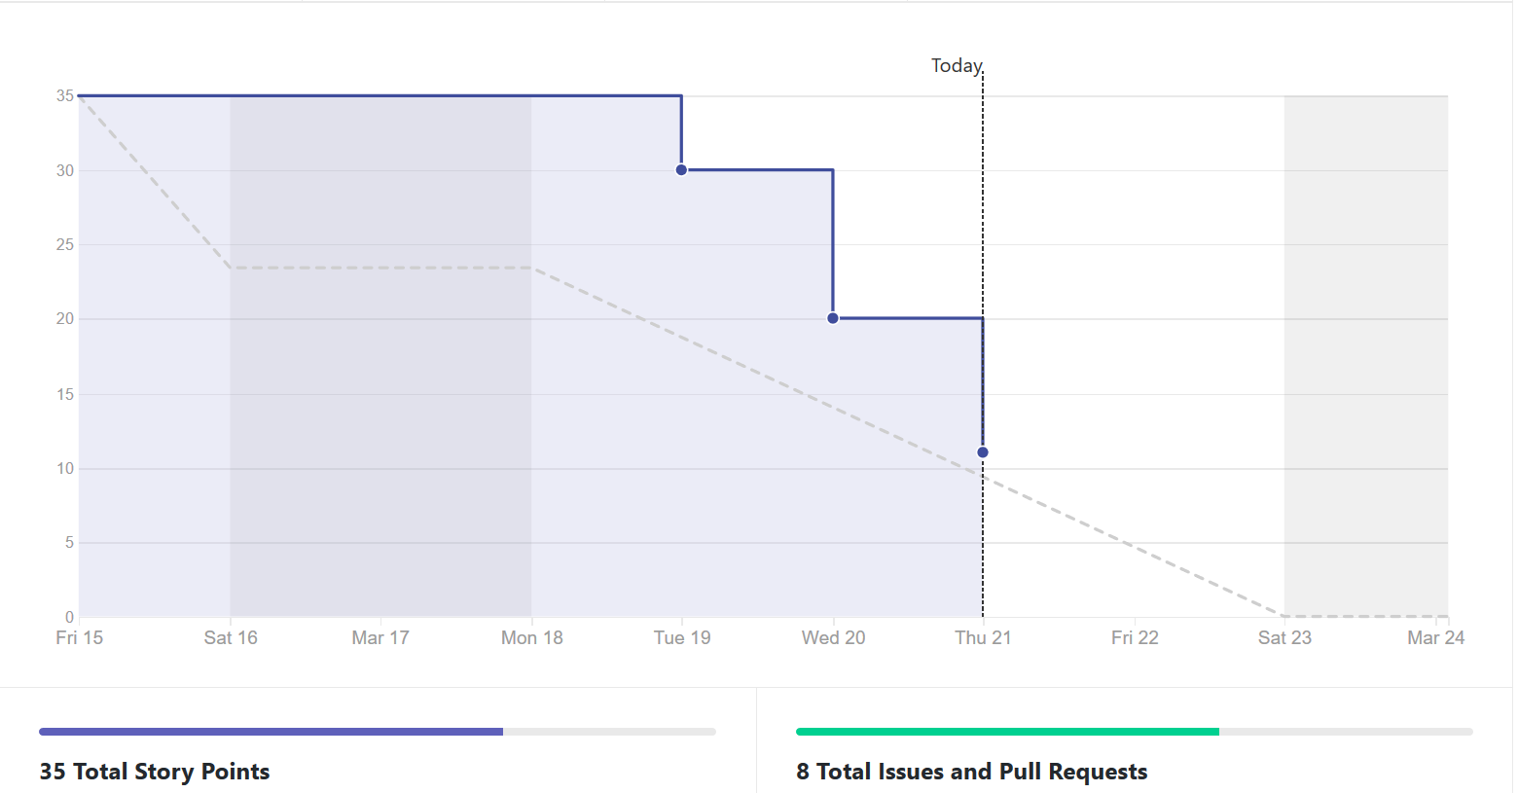
Burndown Report (Last Sprint)

Slide 6
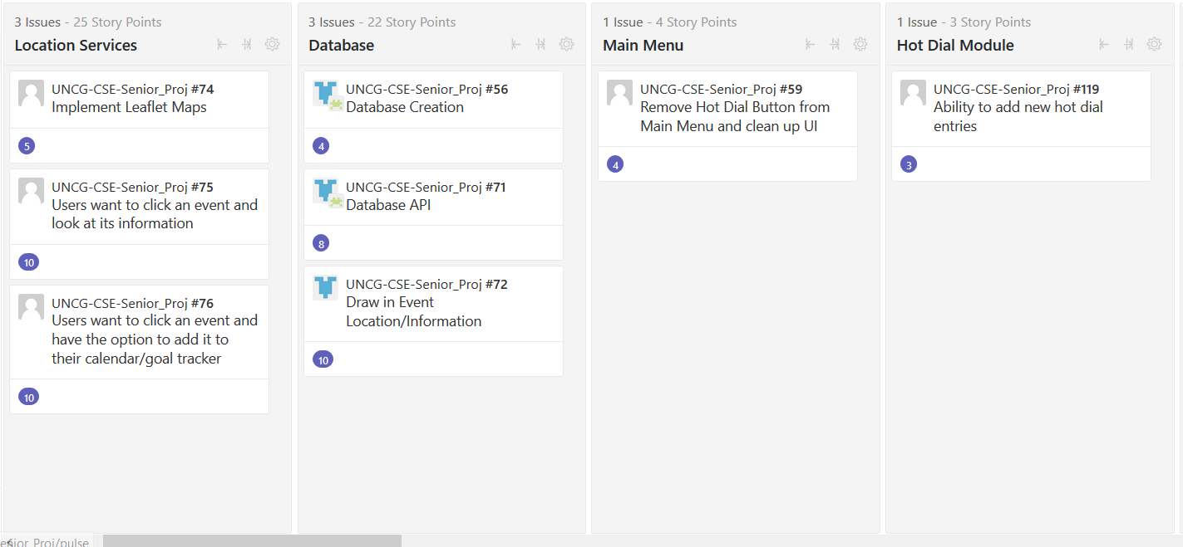
ZENHUB

Slide 7
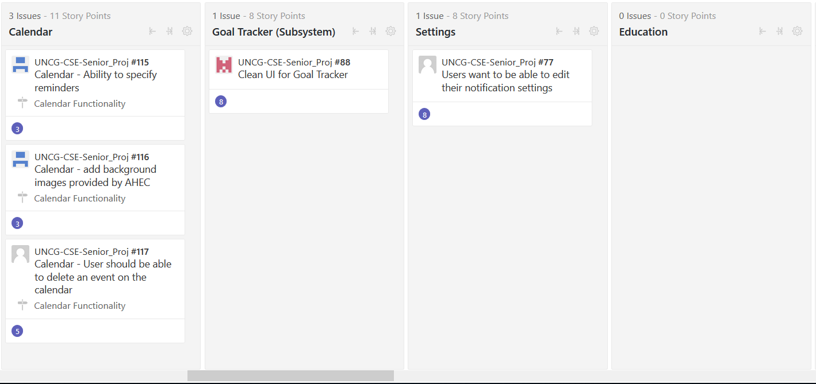
ZENHUB

